Slide 1

Lesson 4:
Random Variables

Slide 2


Introduction

Slide 3

Lecture Overview:
Goals of the lecture:
Differentiate between Discrete and Continuous Random Variables
Understand the Probability Mass and Density Function, Cumulative Distribution Function

Slide 4
Random Variables

Slide 5
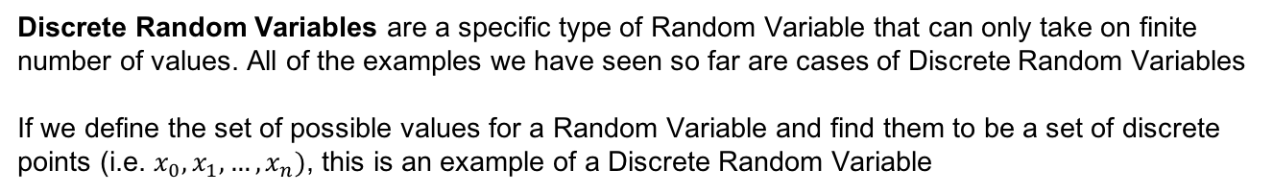
Discrete Random Variables
Definition:
Discrete Random Variables are a specific type of Random Variable that can only take on finite number of values. All of the examples we have seen so far are cases of Discrete Random Variables
If we define the set of possible values for a Random Variable and find them to be a set of discrete points (i.e. $x_{0},x_{1}, …,x_{n})$, this is an example of a Discrete Random Variable
Example 1:
Die
Deck of cards
Age
1
2
3

Slide 6
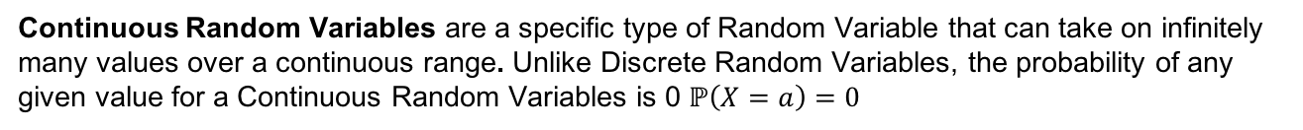
Continuous Random Variables
Definition:
Continuous Random Variables are a specific type of Random Variable that can take on infinitely many values over a continuous range. Unlike Discrete Random Variables, the probability of any given value for a Continuous Random Variables is 0 $ℙ\left(X=a\right)=0$
Example 2:
Height
Temperature
Distance
1
2
3

Slide 7
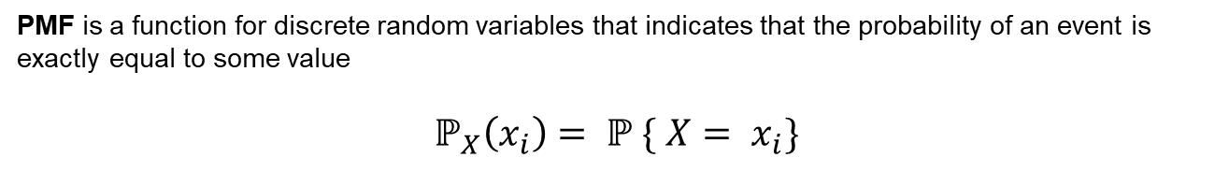
Probability Mass Functions
Definition:
PMF is a function for discrete random variables that indicates that the probability of an event is exactly equal to some value
$$ℙ_{X}\left(x_{i}\right)= ℙ \{ X= x_{i}\}$$
Notes:
Notice the RV here is actually the sum of 2 RVs (X - first roll, Y – first roll), so we can consider this being Z = X + Y and we know that the sum of 2 RVs is also a RV

Slide 8
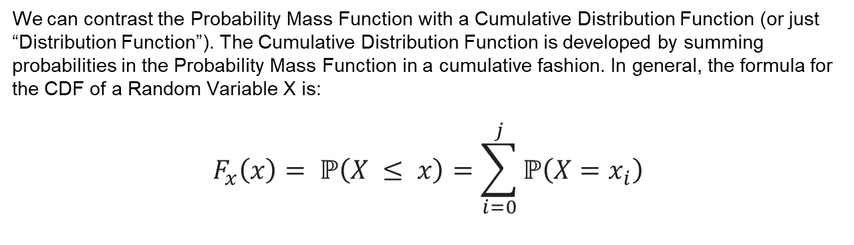
Cumulative Distribution Function
Definition
We can contrast the Probability Mass Function with a Cumulative Distribution Function (or just “Distribution Function”). The Cumulative Distribution Function is developed by summing probabilities in the Probability Mass Function in a cumulative fashion. In general, the formula for the CDF of a Random Variable X is:
$$F_{x}\left(x\right)= ℙ\left(X ≤ x\right)=\sum_{i=0}^{j}{ℙ\left(X=x_{i}\right)}$$

Slide 9
PMF and CMF
Example 3:
PMF and CDF of the sum of two dies

Slide 10
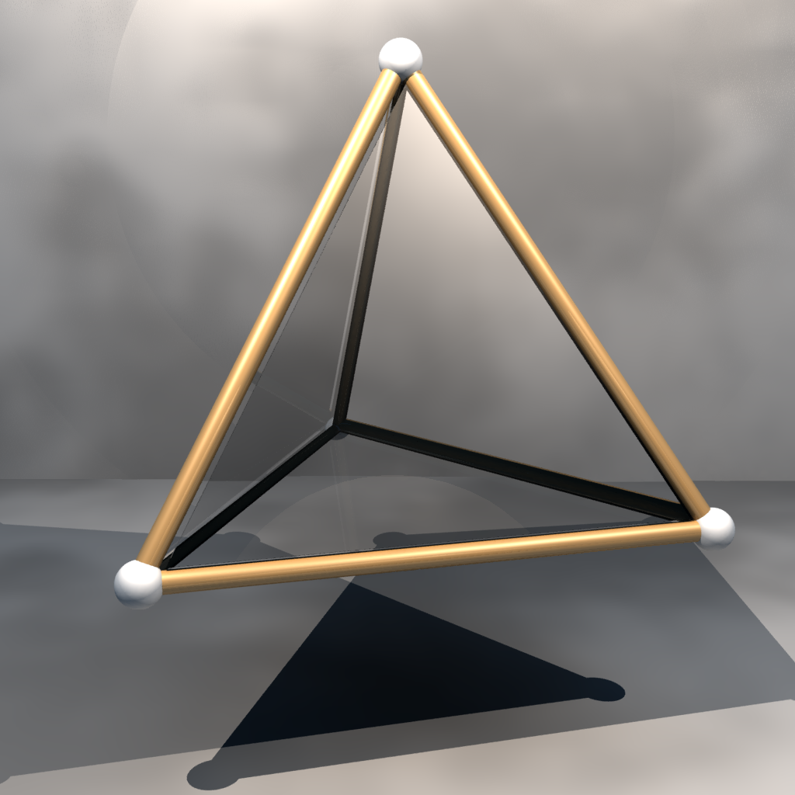
Problem 1
Problem 1:
Assume you have a 4-sided die (S={1,2,3,4}), that is thrown three times.
Draw the PMF and CDF for the sum of the 3 dies. What is the most likely outcome?
What is the probability for the sum of the three dies to be a 10 or higher?

Slide 11
Problem 1
Solution 1:
Most likely outcome is a 7 or 8
$ℙ$(10,11,12) = 1-CDF(9) = 1-0.84 = 0.16

Slide 12
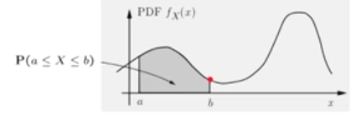
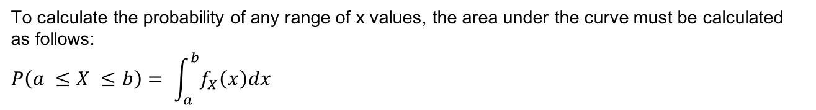
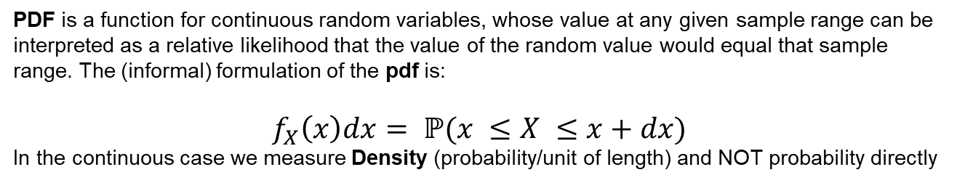
Probability Density Functions
Definition (1):
PDF is a function for continuous random variables, whose value at any given sample range can be interpreted as a relative likelihood that the value of the random value would equal that sample range. The (informal) formulation of the pdf is:
$f_{X}\left(x\right)dx= ℙ(x ≤X ≤x+dx)$
In the continuous case we measure Density (probability/unit of length) and NOT probability directly
Definition (2):
To calculate the probability of any range of x values, the area under the curve must be calculated as follows:
$$P\left(a ≤X ≤b\right)= \int_{a}^{b}{f_{X}\left(x\right)dx}$$

Slide 13
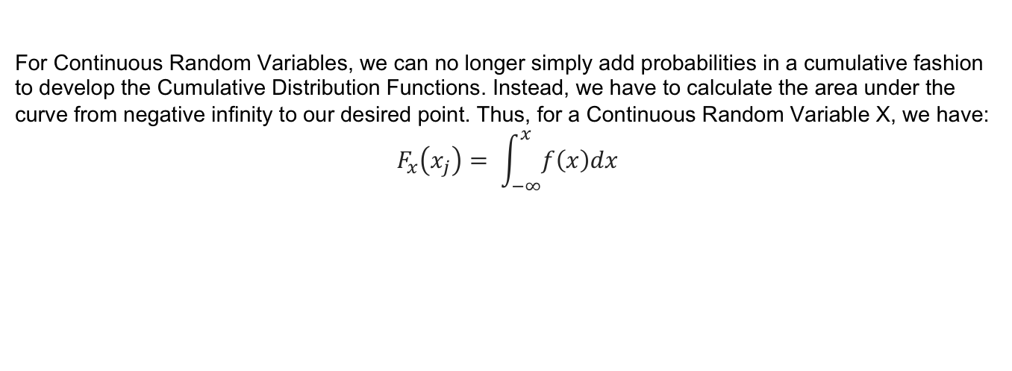
Cumulative Distribution Functions
Definition
For Continuous Random Variables, we can no longer simply add probabilities in a cumulative fashion to develop the Cumulative Distribution Functions. Instead, we have to calculate the area under the curve from negative infinity to our desired point. Thus, for a Continuous Random Variable X, we have:
$$F_{x}\left(x_{j}\right)= \int_{−∞}^{x}{f\left(x\right)dx}$$

Slide 14
Continuous RV and Distribution Functions
Example 17:

Slide 15
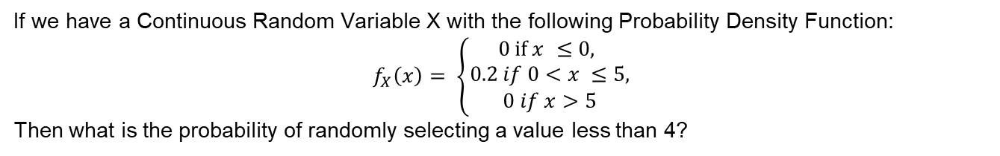
Problem 2
Problem 2:
If we have a Continuous Random Variable X with the following Probability Density Function:
$$f_{X}\left(x\right)= \left\{\begin{aligned}0 \text{if} x ≤\text{0,} \\ 0.2 if 0<x ≤5, \\ 0 if x>5\end{aligned}\right.$$
Then what is the probability of randomly selecting a value less than 4?

Slide 16
Problem 2
Solution 2:
$$F_{x}\left(4\right)= \int_{−∞}^{4}{f_{X}\left(x\right)dx= \int_{0}^{4}{0.2dx= {[0.2x]}_{0}^{4}=0.2\left(4\right)=0.8}}$$

Slide 17
Common Discrete Distributions

Slide 18
Discrete Distributions
Common Discrete Distributions:
Bernoulli Distribution
Binomial Distribution
Poisson Distribution

Slide 19
Common Continuous Distributions

Slide 20
Continuous Distributions
Common Continuous Distributions:
Exponential Distribution
Gamma Distribution
Chi-Squared Distribution
Normal (Gaussian) Distribution
Log-Normal Distribution

Slide 21
More Problems

Slide 22
Problem 3
Problem 3:
In a classroom of 23 people, what is the probability that at least two people have the same birthday? Assume 365 days in the calendar.

Slide 23

Problem 3
Solution 3:
$$ℙ\left(Different Birthdays\right)=\frac{365}{365}\frac{364}{365}\frac{363}{365} …\frac{343}{365}=0.4927$$
$$ℙ\left(at least 2 Birthday\right)=1−ℙ\left(Different Birthdays\right)=1−0.4927=0.5072$$

Slide 24
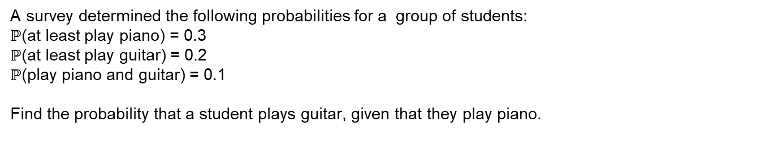
Problem 4
Problem 4:
A survey determined the following probabilities for a group of students:
$ℙ$(at least play piano) = 0.3
$ℙ$(at least play guitar) = 0.2
$ℙ$(play piano and guitar) = 0.1
Find the probability that a student plays guitar, given that they play piano.

Slide 25
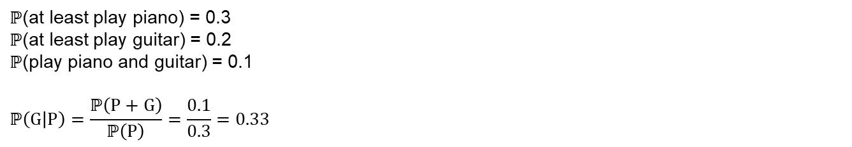
Problem 4
Solution 4:
Ω
$ℙ$(at least play piano) = 0.3
$ℙ$(at least play guitar) = 0.2
$ℙ$(play piano and guitar) = 0.1
$$ℙ\left(G | P\right)=\frac{ℙ\left(P+G\right)}{ℙ\left(P\right)}=\frac{0.1}{0.3}=0.33$$
A
Piano
B
C
D
Guitar

Slide 26
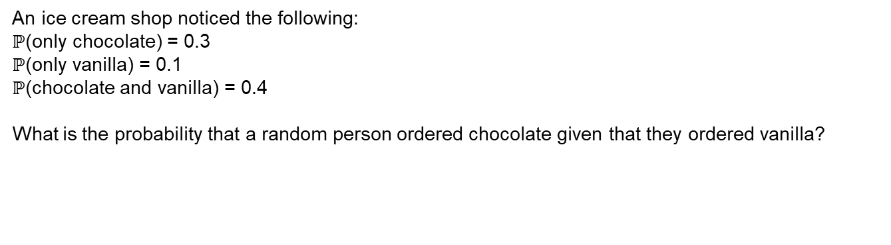
Problem 5
Problem 5:
An ice cream shop noticed the following:
$ℙ$(only chocolate) = 0.3
$ℙ$(only vanilla) = 0.1
$ℙ$(chocolate and vanilla) = 0.4
What is the probability that a random person ordered chocolate given that they ordered vanilla?

Slide 27
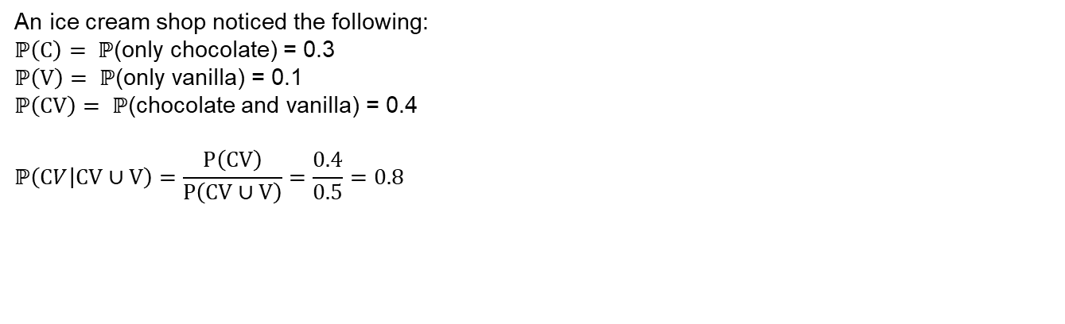
Problem 5
Problem 5:
Ω
An ice cream shop noticed the following:
$ℙ\left(C\right)= ℙ$(only chocolate) = 0.3
$ℙ\left(V\right)= ℙ$(only vanilla) = 0.1
$ℙ\left(CV\right)= ℙ$(chocolate and vanilla) = 0.4
$$ℙ\left(CV | CV∪V\right)=\frac{P\left(CV\right)}{P\left(CV∪V\right)}=\frac{0.4}{0.5}=0.8$$
A
C
CV
V

Slide 28
QUESTIONS?

